Slide 1

Interreg NEXT
Black Sea Basin Programme
Info day
2nd calls for proposals
Constanța, România
23rd of May 2024
2nd calls for project proposals
Slide 1

Slide 2
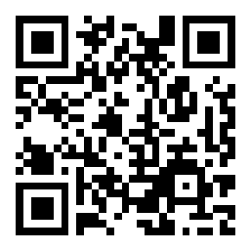
Slido code
#2511691
Interreg NEXT
Black Sea Basin Programme
Info day
2nd calls for proposals
Constanța, Romania
23rd of May 2024
Slide 1

Slide 3
Second call for proposals - Regular projects
Call duration: 3 months (29th of March – 28th of June 2024, 14:00 hrs Romania time)
Financial allocation:
Interreg Funds – 90%:
Total: EUR 31,350,327
Per Specific Objective:
    PO1/SO1 Research: EUR 11,054,293
    PO2/SO4 Climate change: EUR 10,148,017
    PO2/SO7 Nature protection: EUR 10,148,017
Per project: EUR 500,001 – 1,500,000
Project duration: Up to 30 months
Aim at strengthening cooperation by addressing more complex challenges which require higher budgets

Slide 4
Second call for proposals – Small scale projects
Call duration: 3 months (29th of March – 28th of June 2024, 14:00 hrs Romania time)
Financial allocation:
Interreg Funds – 90%:
Total: EUR 15,490,523
Per Specific Objective:
    PO2/SO4 Climate change: EUR 2,000,000
    PO2/SO7 Nature protection: EUR 1,898,174
    ISO1/SO3 Governance: EUR 11,592,349
Per project: EUR 250,000 – 500,000
Project duration: Up to 18 months
Aim: To strengthen people-to-people cooperation in Programme area in the environmental and governance fields through balanced partnerships between eligible legal entities.

Slide 5
Application packs
Application packs available here: www.blacksea-cbc.net
Part I - KEY ASPECTS OF INTERREG VI-B NEXT BLACK SEA BASIN PROGRAMME
Part II – PROJECT MAIN REQUIREMENTS
Part III – OFFLINE APPLICATION FORM TEMPLATE
Part IV – ASSESSMENT, SELECTION AND CONTRACTING
Annexes 1-10

Slide 6

Submission of Application Form – Joint Electronic Monitoring System (JeMS)
VISIBILITY
Creation of manuals, methods, briefs, documentaries and multimedia material based on JOP BSB 2014-2020 experiences
Applications submitted on-line, only by the Lead Partner
Other users (consultants or Partners) allowed to fill in sections of the Application – they can read or add/modify data in the AF, only after the Lead Partner gives the necessary permissions
REGISTER ON EC PARTICIPANT REGISTER PRIOR TO SUBMISSION OF THE APPLICATION!
Creation of manuals, methods, briefs, documentaries and multimedia material based on JOP BSB 2014-2020 experiences
Pre-submission checks automatically made by JeMS - verifies that all sections are filled in with text, not the quality of information!
JeMS does not allow submission of Application unless all fields are filled in.
Take sufficient time for verifications!
What’s new?

Slide 7
Intervention logic

Slide 8

Programme Priorities and Logic
REGULAR
A more competitive and smarter Europe
1. Developing and enhancing research and innovation capacities
Policy Objective 1
Blue and Smart region
Specific Objective
Fields of action
Priority 1
A greener Europe
Clean and Green region
4. Promoting climate change adaptation and disaster risk prevention
7. Enhancing protection and preservation of nature, biodiversity and green infrastructure
Fields of action
SMAL
L
SCAL
E
Policy Objective 2
Priority 2
Specific Objectives
Better cooperation governance
Priority 3
Competent and Resilient Region
Build up mutual trust in particular by encouraging people-to-people actions
Field of action
Interreg Specific Objective 1
Specific Objective
Notes:
Interreg NEXT BSB Programme is in line with 2 policy objectives and one Interreg specific objective, further translated into 3 programme priorities and 4 specific objectives.
While the two first priorities (Priority 1 and Priority 2) were considered when the Programme was initially approved by the EC - December 2022, Priority 3 was added at a latter stage, following the additional allocation of funds from the EC in 2023.
The call for regular projects is opened for priority 1 and 2 and the call for small scale projects is opened for priority 2 and 3.
Within each specific objective the programme identified a number of fields of action. Each project will have to contribute to only one field of action within the selected specific objective.
-----------------------------------------------------------------------------------------
Dezvoltarea și consolidarea capacităților de cercetare și inovare;
Promovarea adaptării la schimbările climatice și prevenirea potențialelor dezastre naturale;
Consolidarea protecției și conservării naturii, a biodiversității și a infrastructurii verzi;
Consolidarea încrederii reciproce, cu accent pe încurajarea interacțiunilor directe între oameni.

Slide 9
Intervention logic
PROJECT
PROGRAMME
Change
Transnational challenges and needs addressed by the project
Transnational challenges and needs of Programme area
Project objectives
Programme
specific objectives
Activities
Fields of actions
Project Outputs
Programme Output indicators
Project Results
Programme Result indicators
Notes:
When developing the project, it is very important to ensure that the Change you want to bring through the project, fits perfectly with and contributes to the Black Sea Basin programme priorities and objectives.
How you do this? What are the main aspects you need to consider apart from finding project partners? La evenimentele in format fizic, la acest moment, putem implica participantii, sau nu, dupa cum se doreste.
In order to develop a good quality project , it is important to carefully consider some key elements:
Identify the key transnational problems, constraints, challenges and opportunities and establish the relationship between the needs which will be addressed by the project and the challenges/needs identified at programme level. In this process, it is important to actively involve the main groups/stakeolders having an interest in the potential project;
Define project overall and specific objective and make sure they are linked to a programme specific objective and priority.
Decide which is the most suitable approach in order to achieve project objectives and then define project activities.
Each project has to be linked to only one field of action within a specific objective.
The approach has to have a transnational character so in the application (through the proposed activities) you have to demonstrate that the project objectives cannot be efficiently reached acting only on a national/regional/local level;
Define project main outputs and results, make sure they are the most relevant ones and that they can be correcly linked to and measured by the programme output and result indicators – in the next slides we go through all these indicators .
Plan the resources – human and financial.
The coherence of the project intervention logic (project main and specific objective, activities, outputs and results) with the programme intervention logic (specific objectives, output and result indicators) is a pre-condition for a project to be funded.
Projects not showing a clear link to a programme specific objective and/or not contributing to the programme results will not be funded in the programme’s framework.

Slide 10

Programme logic
Results
Outputs
Project logic
Activity 1
Activity 2
Activity N
Work package
CHANGE
CHALLENGE
Specific objective
Overall objective
Notes:
This slide ilustrates the main structure of a project and the link between the project logic with the programme logic.
The intervention logic should reflect the path of the project and the necessary steps that will lead to change. It should be clear, simple and easy to monitor and implement.
Please note that the logic of the intervention logic will be scored.

Slide 11
 |  | Priority 1 BLUE AND SMART EUROPE | Priority 2 CLEAN AND GREEN REGION |  | Priority 3 COMPETENT AND RESILIENT REGION
 | INDICATOR | SO1 - Research and innovation | SO4 – Climate change | SO7 – Preservation of nature | SO3 – Mutual trust
OUTPUT | RCO07 Research organizations participating in joint research
 | RCO81 Participations in joint actions across borders
 | RCO87 Organisations cooperating across borders
 | RCO84 Pilot actions developed jointly and implemented in projects
 | RCO115 Public events across borders jointly organised
 | RCO116 Jointly developed solutions
RESULT | RCR84 Organisations cooperating across borders after project completion
 | RCR104 Solutions taken up or up-scaled by organisations
Programme indicators
Notes:
It is important that project main outputs and results are identified so that they clearly be captured and contribute to a programme output and result indicator.
All projects will have to contribute to RCO 87 – mandatory.
An important document elaborated by the programme is the Performance Framework Methodology which provides definitions of the indicators, criteria to be fulfilled and clear explanations on how to quantify the targets and measure their achievement .
In addition – Fiches on each indicator - Annex 10 to the guidelines – which is a summary of the information contained in the performance framework.
When identifying the main outputs, make sure they full comply with the criteria of the Programme output indicators and can be linked to a related programme indicator.
Correctness of outputs and their linkage with the programme indicators will be assessed and scored.

Slide 12

Organisations cooperating across borders (RCO87)
Organizations cooperating across borders after project completion (RCR84)
Definition: counts the organisations cooperating formally in supported projects
Criteria: organisations counted in this indicator are the legal entities as mentioned in the application
Example: project partners = 4 target value of RCO87 = 4
This indicator is compulsory for all projects

Slide 13
Research organisations participating in joint research projects (RCO07)
Organizations cooperating across borders after project completion (RCR84)
Definition: counts the number of supported research organisations that cooperate in joint research projects.
Criteria (cumulative):
  at least one partner be a research organisation, and
  actively participate in the implementation of a joint research project.
Examples: universities or research institutes, technology transfer agencies
Only for SO1
Complements RCO87 (same organization may be counted both under RCO07 and RCO87)
Notes:
Research organisations = bodies with a primary goal to conduct independently fundamental research, industrial research and experimental development and to disseminate the results of such activities by way of teaching, publication or knowledge transfer.
RCR 84
Counts the organizations cooperating across borders after the completion of the supported projects;
Measures will be put in practice in order to monitor the cooperation activities after the project ends (sustainability reports)
Example for RCR 84-There are 3 project partners but they decide that after the project will be finalized only 2 of them will continue to collaborate and will sign the Memorandum of Understanding as well.

Slide 14
Public events across borders jointly organized (RCO115)
Organizations cooperating across borders after project completion (RCR84)
Definition: counts the number of events (joint actions) across borders jointly organized by the partners.
Criteria (cumulative):
  be advertised to the general public, and
  be jointly organised by at least 2 partners, and
  involves stakeholders outside the partnership from at least 2 countries
Examples: trainings, workshops and seminars organized in the framework of the project, launching and final Conference of the project
Does not count: - the number of participations in public events
- the participation of the project staff in public events
Notes:
Internal working meetings, steering committees of the project staff are not considered as public events.
RCR 84
Counts the organizations cooperating across borders after the completion of the supported projects;
Measures will be put in practice in order to monitor the cooperation activities after the project ends (sustainability reports).

Slide 15
Participations in joint actions across borders (RCO81)
Organizations cooperating across borders after project completion (RCR84)
Definition: counts the number of participations in joint actions across borders implemented in the supported projects.
Criteria (cumulative):
  joint actions (also on line, if justified) - organisations from at least 2 countries, and
  participation of persons outside the partnership.
Example: number of participants from one participating country to a study visit in another participating country
Only for SO3
  Does not count: - participations in public events (as defined by RCO 115)
- participations in internal project meetings of the partners
Notes:
RCO 81
Joint actions across borders could include, for instance, exchange activities or exchange visits organized with partners across borders.
Participations (i.e. number of persons attending a joint action across borders - e.g. citizens, volunteers, students, pupils, public officials, etc.) are counted for each joint action organised on the basis of attendance lists or other relevant means of quantification.
A joint action is considered as the action organised with the involvement of organizations from at least two participating countries.

Slide 16
Research organisations participating in joint research projects (RCO07)
Organizations cooperating across borders after project completion (RCR84)
Participations in joint actions across borders (RCO81)
Organisations cooperating across borders (RCO87)
Public events across borders jointly organized (RCO115)
Definition: counts the organizations cooperating across borders after the completion of the supported projects
Criteria:
  refers to organisations involved in project implementation;
  have a cooperation agreement to continue cooperation after the end of the supported project (document to be signed and provided during contracting stage);
  cooperation could be on a similar or different topic.
Example: project partners = 6; if only 2 (or n) partners continue cooperation
target value of RCR 84 = 2 (or n)
Other project partners may sign the agreement at a later stage before the end of the project.
Notes:
RCR 84
The organizations are legal entities involved in project implementation.
Measures will be put in practice in order to monitor the cooperation activities after the project ends (sustainability reports)
-The evidence on the commitment of the partner organizations to cooperate after the project ends its implementation period will be a cooperation agreement signed during the contracting stage.
-Multiple counting will be removed at the level of the specific objective. An organisation is considered once regardless how many times it receives support from operations in the same specific objective.

Slide 17
Jointly developed solutions (RCO116)
Solutions taken up or up-scaled by organisations (RCR104)
Definition: counts the number of jointly developed solutions from joint actions (including as a result of pilot actions) implemented by supported projects
Solution = an action or a process of solving a problem
Criteria (cumulative):
  be jointly developed (draft and design) by project partners from at least 2 countries, and
  be developed during project implementation, and
  include indications of the actions needed for it to be taken up or to be up-scaled.
Examples: jointly developed platform, IT tool, data base, data collection method, etc.
1 solution developed (RCO 116) – 1 solution tested (RCO 84) 1/0 solution further implemented (RCR 104)
Notes:
RCO 116
An identified solution should include clear indications of the actions needed for it to be taken up or to be upscaled;
Implies the involvement of organizations from at least two participating countries in the drafting and design process of the solution.
Example: methodologies, IT Tools, management plans;
Example for RCO84-116 and RCR 104:
The project develops an innovative technical solution (RCO84) to select and recycle garbage, which has to be piloted (RCO116). This solution could be taken up by other organizations or further developed by the organizations from the projects after the project is finalized (RCR104).

Slide 18
Pilot actions developed jointly and implemented in projects (RCO84)
Solutions taken up or up-scaled by organisations (RCR104)
Definition: counts the pilot actions developed jointly and implemented by a project;
Pilot action = a practical implementation of newly developed solutions
Criteria (cumulative):
  needs to be developed AND implemented within the project, and
  implementation should be finalised by the end of the project, and
  it implies the involvement of organizations from at least 2 countries.
Examples:
  a small scale investment to test the effectiveness of a solution;
  a data collection/algorithm tested or piloted in a relevant organisation by the end of the project;
  an existing method applied to demonstrate its applicability to a certain sector/territory.
Notes:
RCO 84
Scope = to test procedures, new instruments, tools, experimentation or the transfer of practices;
Examples: services, tools, methods or approaches, even a pilot small scale investment

Slide 19
Pilot actions developed jointly and implemented in projects (RCO84)
Solutions taken up or up-scaled by organisations (RCR104)
Jointly developed solutions (RCO116)
Definition: counts the number of solutions and/or pilot actions, other than legal or administrative solutions, that are developed by supported projects AND are taken up or up-scaled during the implementation of the project or within one year after project completion.
Criteria:
  organisations adopting the solutions developed by the project may or may not be a participant in the project;
  the uptake / up-scaling should be documented by the adopting organizations in strategies, action plans etc.
Examples: Jointly developed platform, IT tool, data base, data collection method, etc.
1 solution developed (RCO116) – 1 solution tested (RCO84) – 1/0 solution further implemented (RCR104) target value of RCR104 = n/0
Notes:
Examples: A jointly developed platform, IT tool, data base, data collection method, solution (RCO 116), which could also be piloted/tested) (RCO84) is actually implemented by one (or several) of the partners in their own organisation(s) or in other organisation(s) during the project duration or within one year after project completion (RCR104).

Slide 20
Intervention Logic
Main takeaways:
RCO87 - compulsory for all projects;
Make sure that project objectives, activities and outputs are logically linked to the targeted Programme specific objectives and field(s) of action;
Demonstrate that project clearly contributes to the programme output and result indicator(s) - ! many outputs and results ≠ higher project score;
Be realistic when defining the target values - ! high target values ≠ higher project score;
Lead Partner – coordination role in definition and quantification of realistic target values for project indicators.

Slide 21
Application form – main parts in JEMS
Part A - Project identification
A1 Project identification
A.2 Project summary
A.3 Project budget overview
A.4 Project outputs and result overview
Part B – Project partners
B.0 Partners overview
B.1 Project partner - Budget – options
B0 - administrative and eligibility assessment
Part C – Project description
C.1 Project overall objective
C.2 Project relevance and context
C.3 Project partnership
C.4 Project workplan - Specific objective – Activities - Outputs
C.5 Project results
C.6 Time plan
C.7 Project management and communication
C.8 Long-term effects and durability
Part D – Project budget overview
B1 & C - quality assessment
Notes:
In Part III of the Guidelines there are details provided on how to fill in each section.
Annex 7 to the Guidelines is the Grid which will be used for strategic and operational assessment. Recommend to read the criteria.

Slide 22
FINANCIAL REQUIREMENTS

Slide 23

Payment arrangements
and reporting
Annex 9 of
Application Packs
-Grant Contract-
New
- recovered by deducting 20% from the eligible value of the Interreg funds included in the next payment requests until the amount is cleared
1
Advance payment – maximum 30%
Several interim payments – linked and based on actual expenditure made and reported
N
Reports – cover 4 months implementation period
- time needed for preparation and submission to the controllers for expenditure verification
- include technical and financial information

Slide 24



Budget structure – regular projects
1. Staff – up to 20% of the eligible direct costs other than staff costs
2. Office and administration (indirect) - up to 7% of the eligible direct costs
- Set in Jems the percentage based on your estimated needs – the amount shall be automatically calculated in Jems
- No justifying/supporting documents required, except for a document proving the existence of the Staff cost category
Flat rate
3. Travel and Accommodation
4. External expertise and services
Real costs
5. Equipment
6. Infrastructure and works
- Justifying/supporting documents required
- Certification by the controller required

Slide 25
Budget – small-scale projects – option 1
The eligible costs for small scale projects are based on:
Real costs
Staff costs
- Justifying/supporting documents required
- Certification by the controller required
Flat rate
Other costs calculated as 40% of eligible direct staff costs covering the budget categories:
    Office and Administration
    Travel and Accommodation
    External expertise and services
    Equipment
- NO justifying/supporting documents required
- NO certification by the controller required, directly linked to the expenditures certified as eligible for Staff costs
Automatically calculated in Jems
Notes:
The amount of costs which will be reimbursed as flat rate of 40% of the direct eligible staff costs is directly linked to the expenditures certified as eligible for Staff costs during the management verification and are calculated automatically by Jems in each financial report.

Slide 26
Budget – small-scale projects – option 2
Staff
Real costs
Travel and accomodation
External expertise and services
Equipment
- Justifying/supporting documents required
- Certification by the controller required
Office and administration (indirect) - up to 7% of the eligible direct costs
- Set in Jems the percentage based on your estimated needs
– The amount will be automatically calculated in Jems by applying the percentage of up to 7%, as decided by each partner, to the total eligible direct costs of the respective partner
- No justifying/supporting documents required
Flat rate

Slide 27
Information about the calls
More information about the calls and the Application Packs may be checked/downloaded at: https://blacksea-cbc.net/interreg-next-bsb-2021-2027/calls-for-proposals/second-call-for-proposals
Help Desk
Any request for clarifications may be addressed until 14th of June 2024 to the Joint Secretariat at: office@bsb.adrse.ro
Last date on which clarifications are issued by JS shall be 21st of June 2024

Slide 28

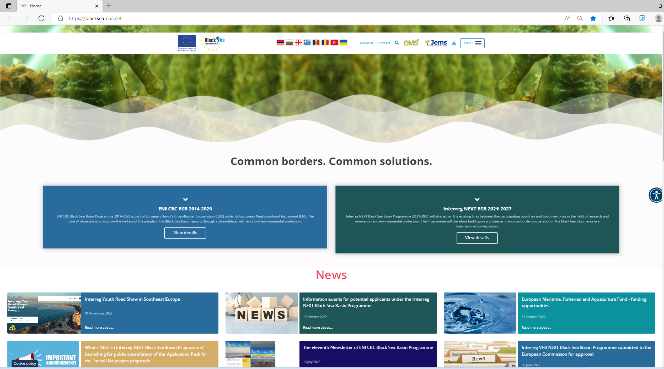
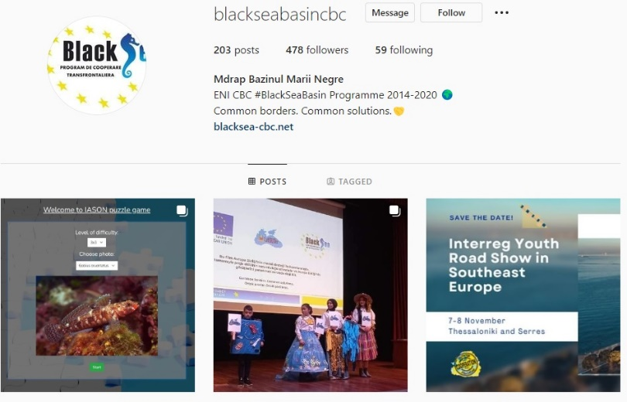
www.facebook.com/BlackSeaBasin/
Help desk:
office@bsb.adrse.ro
www.blacksea-cbc.net
www.instagram.com/blackseabasincbc/

