Slide 1



Interreg VI-B
NEXT Black Sea Basin
Programme
strategy
2021-2027
projects
about
budget
area
contact

Slide 2
Interreg NEXT Black Sea Basin Programme
An Interreg Programme assuring the continuation of cooperation within the Black Sea Basin, building upon the results and lessons learned under ENI CBC Black Sea Basin Programme 2014-2020 & ENPI CBC Black Sea Basin Programme 2007-2013
budget
strategy
projects
contact
area
about

Slide 3
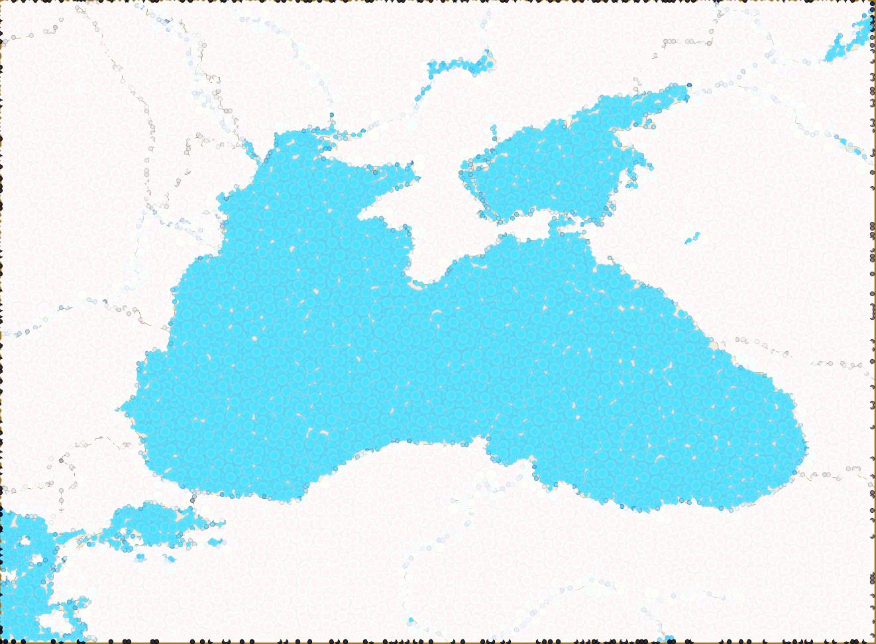
Republic of Moldova
Ukraine
Odessa oblast, Mykolaiv oblast, Kherson oblast, Zaporizhzhia oblast and Donetsk* oblast
The whole country
* According to the decision of Ukraine, submitted in the context of confirmation of the geographical coverage of the programme with a view to prepare the
Implementing Act, the following districts from Donetsk are eligible: Bakhmut, Kramatorsk, Volnovakha, Mariupol, Pokrovsk.
Romania
South-East Region
strategy
projects
budget
area
contact
about
Bulgaria
Severoiztochen and
Yugoiztochen regions
Black Sea Basin
eligible area
Georgia
The whole country
Greece
Armenia
Kentriki Makedonia and
Anatoliki Makedonia Thraki regions
The whole country
Türkiye
TR10 (İstanbul), TR21 (Tekirdağ, Edirne, Kırklareli), TR42 (Kocaeli, Sakarya, Düzce, Bolu, Yalova), TR81 (Zonguldak, Karabük, Bartın), TR82 (Kastamonu, Çankırı, Sinop), TR83 (Samsun, Tokat, Çorum, Amasya), TR90 (Trabzon, Ordu, Giresun, Rize, Artvin, Gümüşhane)

Slide 4
* Interreg NEXT Black Sea Basin Programme is supported by:
ERDF (European Regional Development Fund)
NDICI – Global Europe (Neighbourhood, Development and International Cooperation Instrument)
IPA (Instrument for Pre-Accession Assistance)
72.28 mil. Euro
Total Budget
strategy
budget
projects
about
contact
area
65.05 mil. Euro
10 %
Interreg Funds *
Co-financing

Slide 5
A more competitive and smarter Europe
by promoting innovative and smart economic transformation and regional ICT connectivity
Policy Objective 1
Blue and Smart region
Priority
1. Developing and enhancing research and innovation capacities and the uptake of advanced technologies
Specific Objective
The fields and indicative types of actions to be financed under each specific objective are detailed within the approved Programme and may be consulted at https://blacksea-cbc.net
contact
projects
about
strategy
budget
area
4. Promoting climate change adaptation and disaster risk prevention and resilience, taking into account eco-system based approaches
7. Enhancing protection and preservation of nature, biodiversity and green infrastructure, including in urban areas, and reducing all forms of pollution
Specific Objectives:
A greener, low-carbon transitioning towards a net zero carbon economy and resilient Europe
by promoting clean and fair energy transition, green and blue investment, circular economy, climate change mitigation and adaptation, risk prevention and management, and sustainable urban mobility
Policy Objective 2
Clean and Green region
Priority

Slide 6
Types of projects financed under the Programme:
Small scale projects
Indicative project budget (EU funds):
Budget (EUR)
250,000 (EUR)
500,000 (EUR)
about
strategy
budget
area
contact
projects
Regular sized
Projects*
Indicative project budget (EU funds):
500,001 (EUR)
1,500,000 (EUR)
* To be financed by the largest share of the Programme budget

Slide 7


https://blacksea-cbc.net
about
strategy
budget
contact
area
projects
contact
https://www.facebook.com/BlackSeaBasin
https://www.instagram.com/blackseabasincbc

